Slide 1

Speed comparison of convolutional neural networks in TensorFlow
25th June 2018
Bachelor Thesis – Juan Luis Ruiz-Tagle Oriol
Examiner: Anne Håkansson

Slide 2
BackGround
Machine learning and ANN
Convolutional Neural Networks
TEnsorFLOW

Slide 3
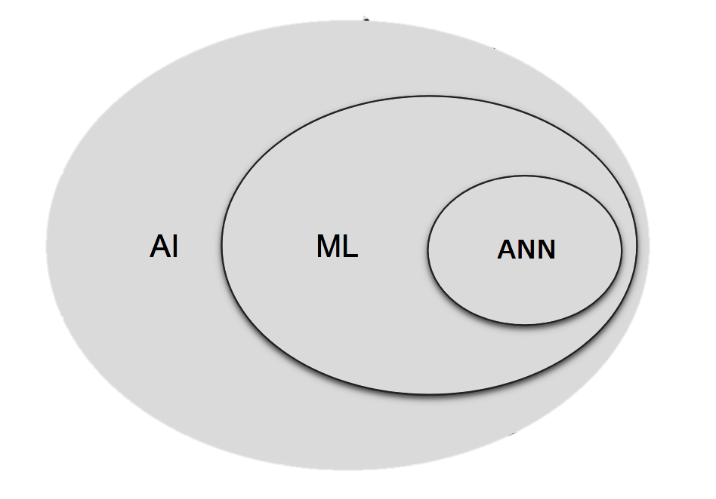
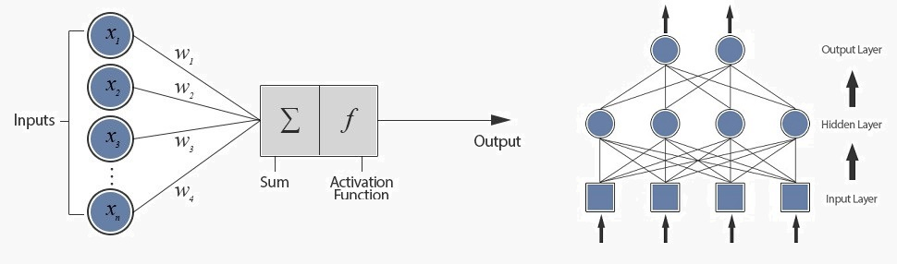
Machine learning and Artificial neural networks
ML: algebraic and statistical methods to find patterns in data. Training with many datapoints.
ANN: inspired biological brain. Set of nodes with weights which readjust progressively

Slide 4

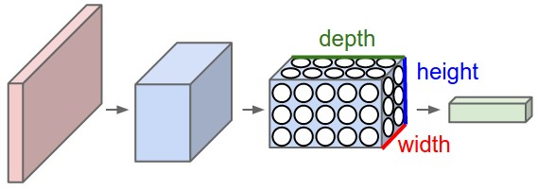
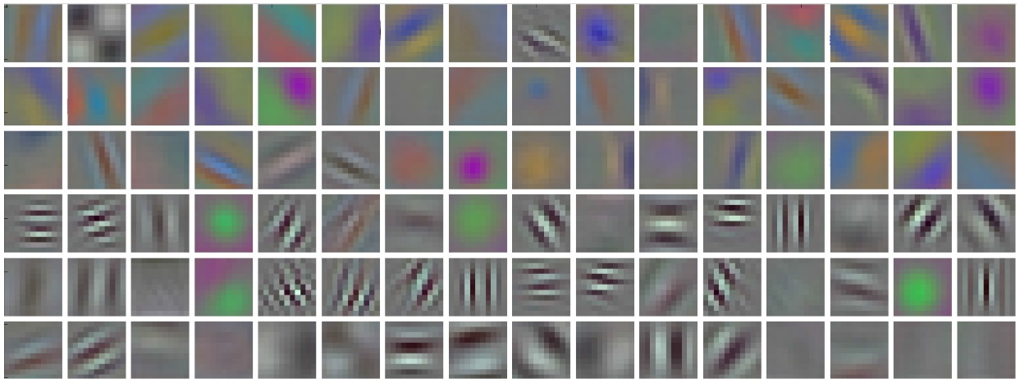
Convolutional Neural Networks
CNNs: special kind of ANN which usually takes an image as an input. Used in computer vision.
Problem: fully connected ANNs don’t scale properly. Computational power.
Solution: shrink image and abstract patterns progressively across layers.
Filters
Inception filters

Slide 5

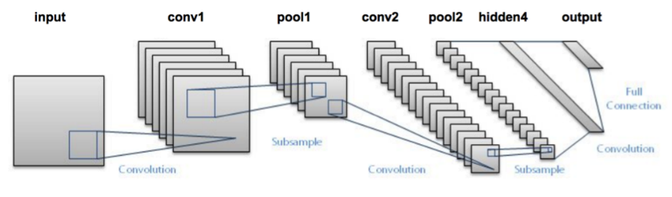
Types of Layers in CNns
Max pooling
Convolutional layers.
Pooling layers
Fully connected layers
Typical structure

Slide 6

TEnsorFlow
TensorFlow: Library for ML→ Open-sourced by Google 2015.
Versions for mobile devices:
TensorFlow Mobile. Meant to be replaced.
TensorFlow Lite: (nov 2017). Evolution
TensorFlow Lite pros:
Smaller binary size (Protobuffer)
Better performance and fewer dependencies
TensorFlow Lite cons:
It is in developer preview. Not optimized
Doesn’t support yet all operations.

Slide 7

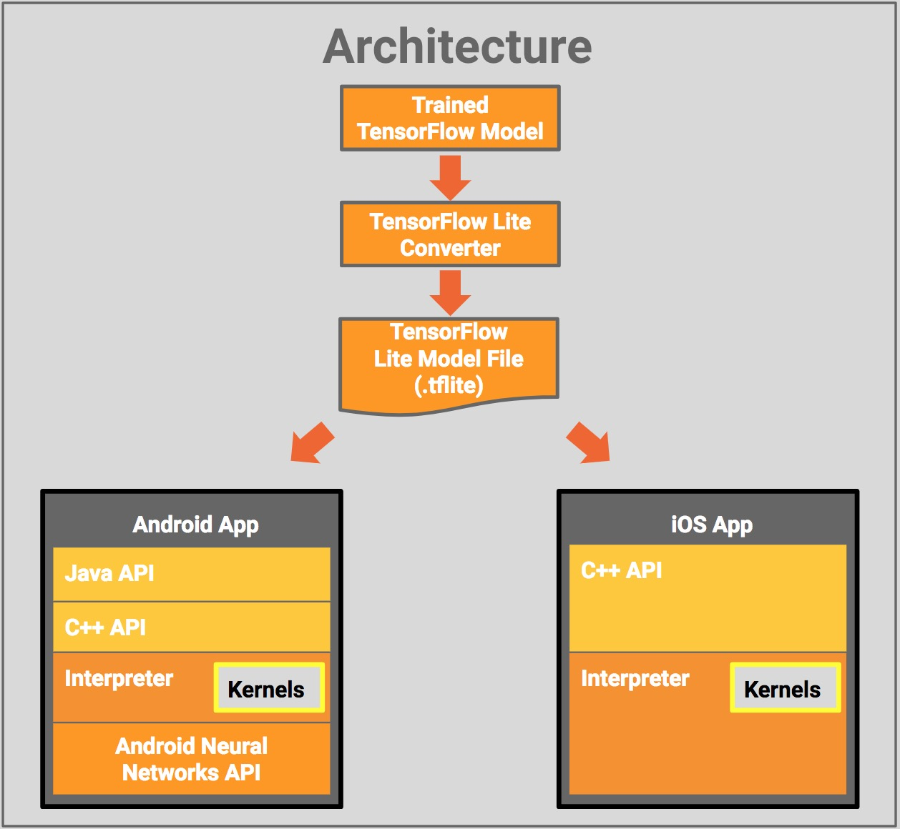

Slide 8

Defining the thesis

Slide 9
Defining The Thesis: Problem statement
How does the execution speed of a CNN change
when run in TensorFlow Lite
compared to TensorFlow Mobile?

Slide 10
Defining The Thesis: Purpose and GOals
Purpose: present the variation of the execution speed of a CNN run in both TensorFlow Lite and Mobile
Goal: provide with a solution in the form of an Android application
which allows the comparison of the execution speed of a CNN
Subgoals:
Export graph
Develop a deliverable application
Install app in devices and test

Slide 11

Stakeholders: Slagkryssaren
SKCC Project: Slagkryssaren Credit Card

Slide 12
Methodologies
Deductive reasoning
Experimental research
Experiment
Statistics
Research approach
Research design
Data collection methods
Data analysis methods.
Android Studio
Git Flow
Software methods

Slide 13
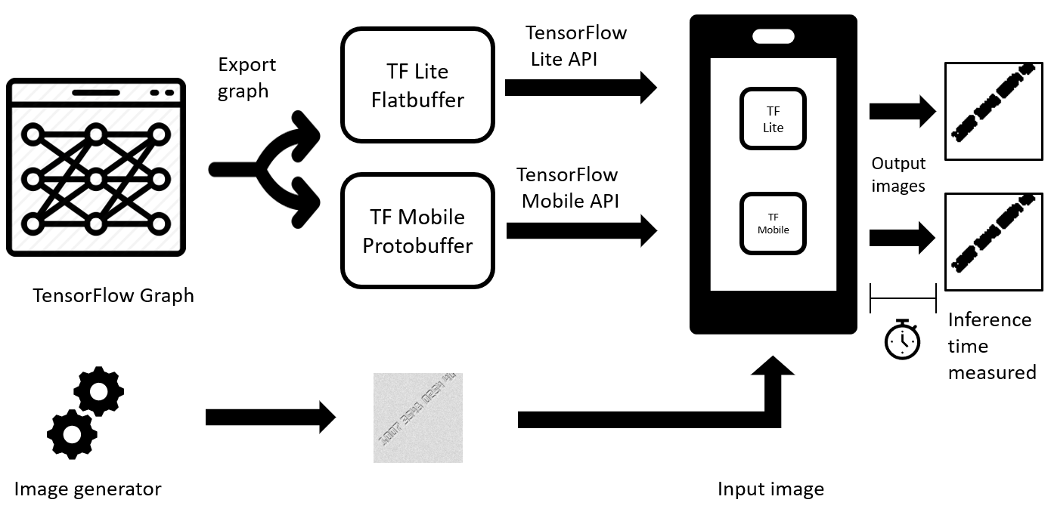
Project Design
Requirements
Project Design
Test speed on several devices with different versions of the OS
Test with different image sizes.
Code not to be shared
Use Git with Bitbucket

Slide 14

Implementation of the test application
Exporting the Graph
Development oF Test application

Slide 15
Exporting the graph
TF Mobile
Tf Lite
freeze_graph()
TOCO convert
write_graph()
model.lite
Freeze the graph: convert variable values for the weights in constant values.
Export:
TensorFlow Mobile Protobuffer (model.pb or model.pbtxt)
TensorFlow Lite Flatbuffer (model.lite)
model.pb

Slide 16
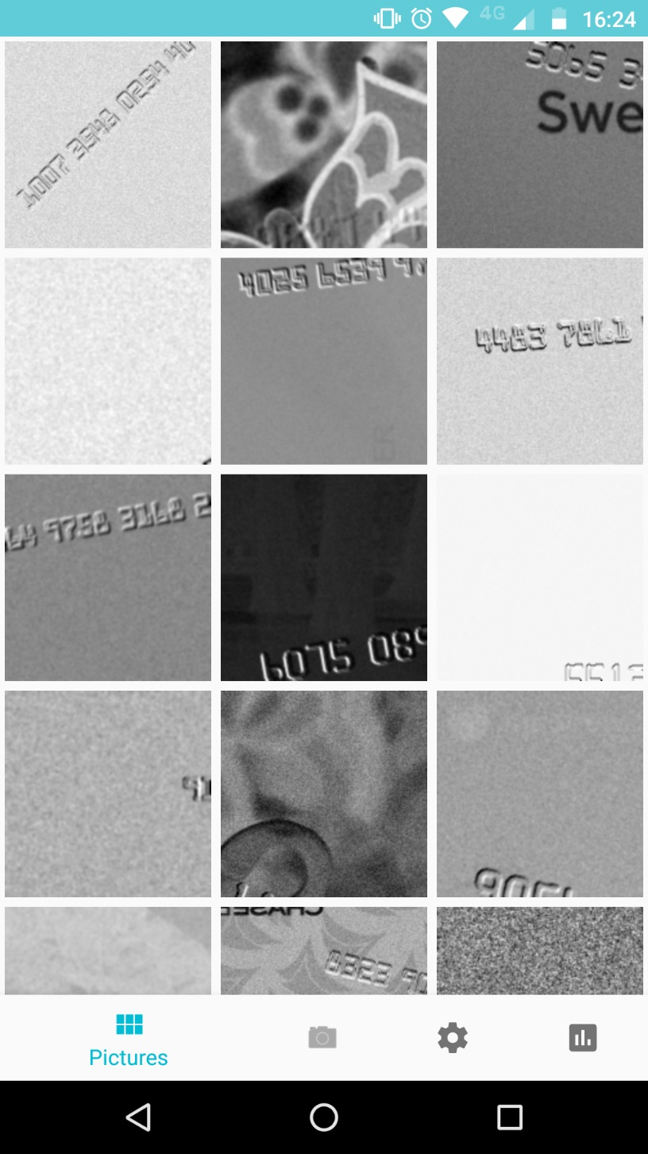
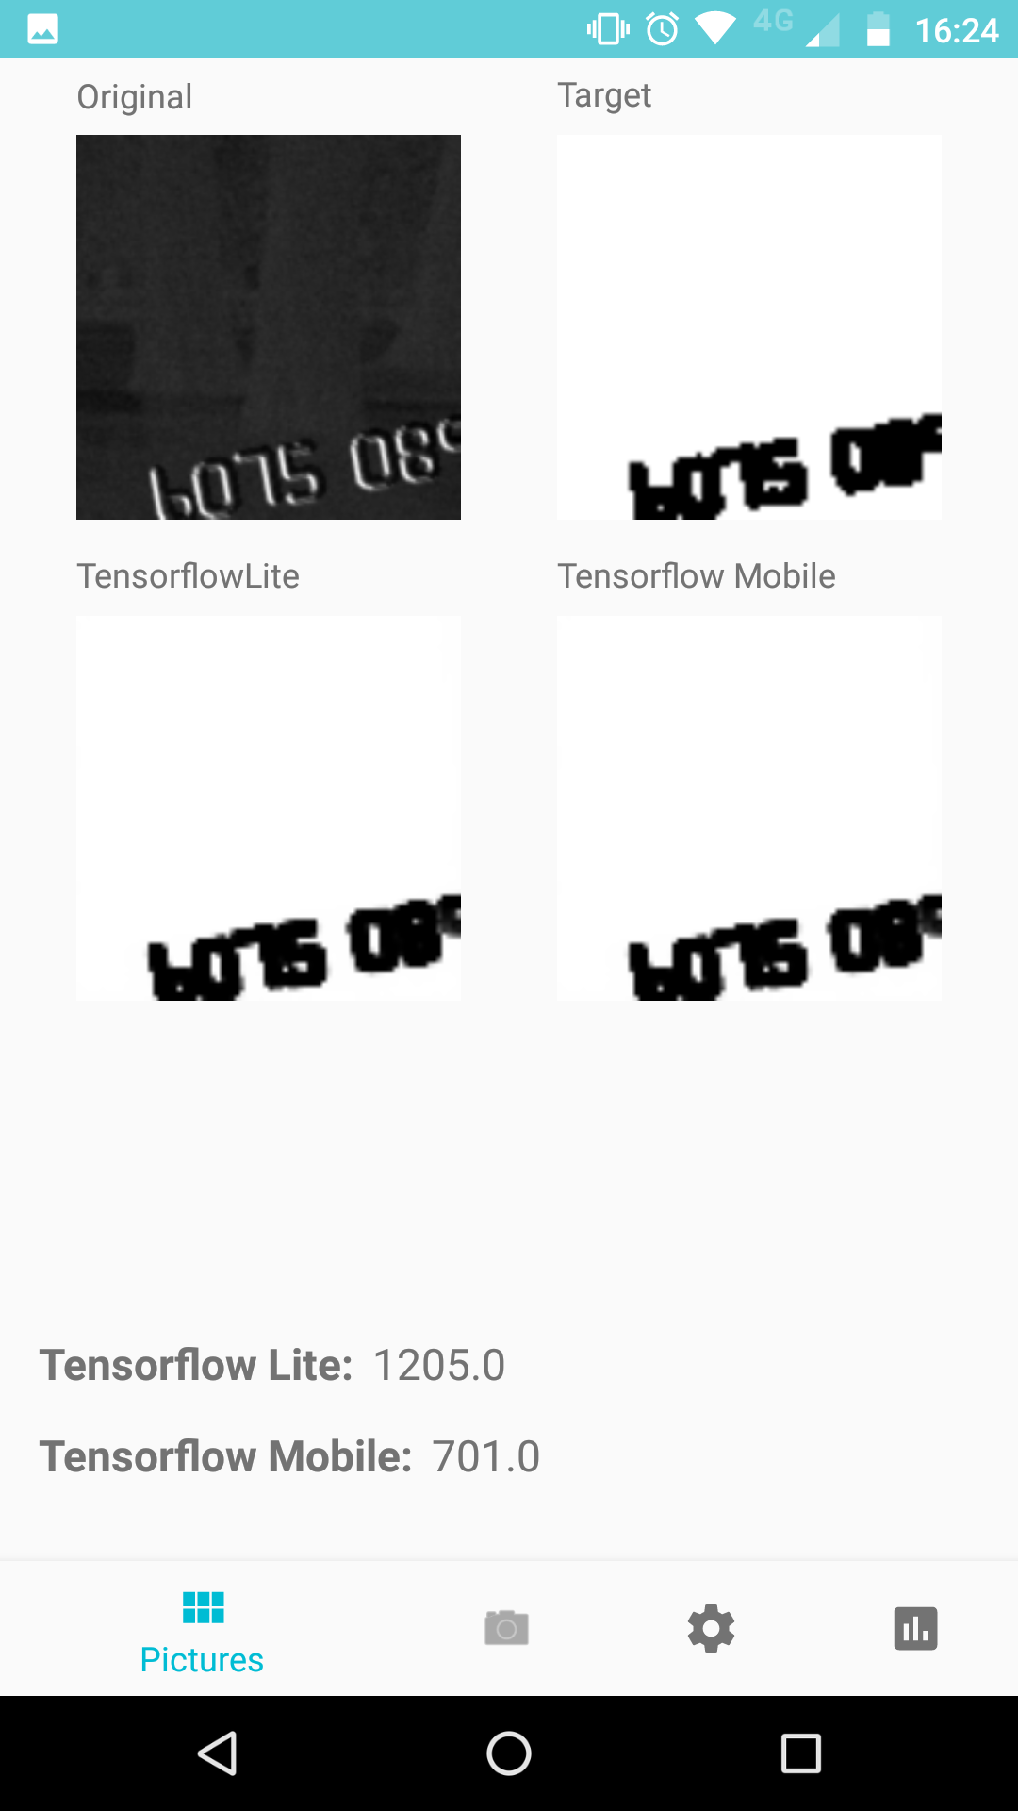
Development of Test Application

Slide 17
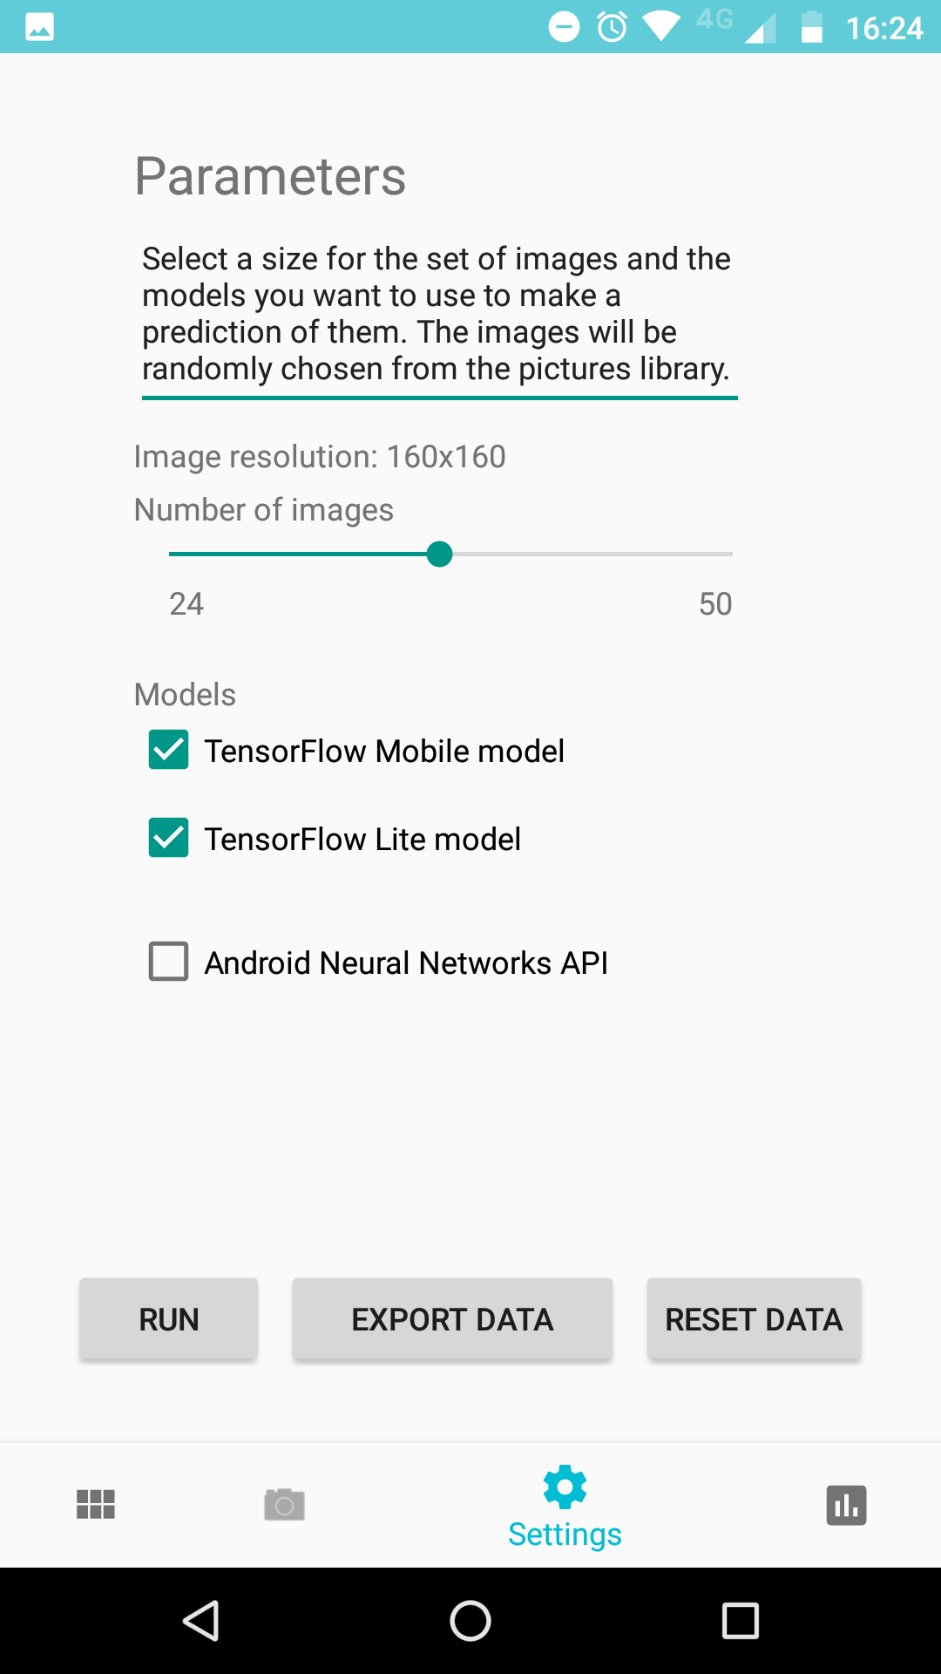
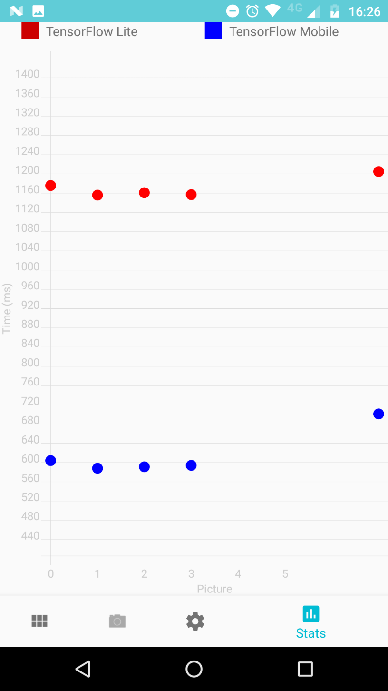
Development of Test Application

Slide 18
TESTING

Slide 19
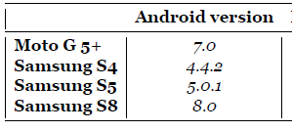
Quality Assurance
Validity: Android Profiler
Reliability:
Several devices different OS
Data collected: 150 datapoints/device
Standard deviation low
Replicability: install the app yourself

Slide 20
Results of the Tests: AVERAGE TIME
 | Image 160x160 px |  | Image 240x240 px |  | Image 320x320 px
 | Tf Mobile | Tf Lite | Tf Mobile | Tf Lite | Tf Mobile | Tf Lite
Moto G 5+ | 577,66 | 1148,74 | 1276,94 | 2562,28 | 2259,64 | 4542,26
Samsung S4 | 516,9 | 1397,58 | 1307,1 | 3562,82 | 3360,74 | 9679,18
Samsung S5 | 462,9 | 1006,38 | 931,6 | 2212,34 | 2587,76 | 5777,78
Samsung S8 | 182,44 | 371,52 | 410,12 | 814,16 | 757,34 | 1494,28

Slide 21
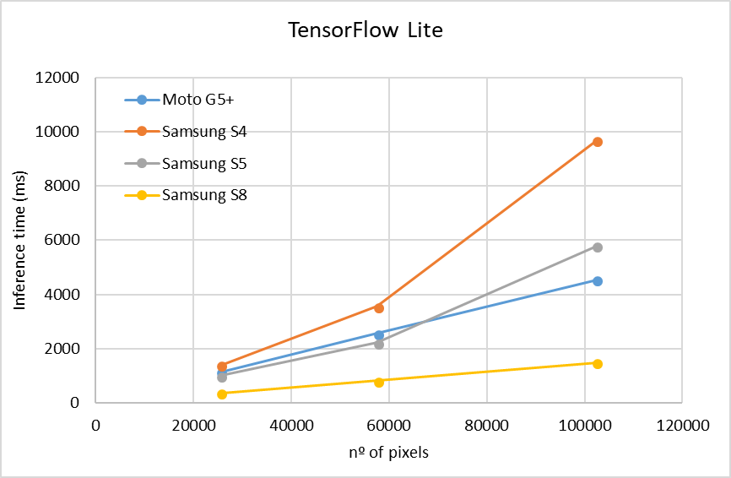
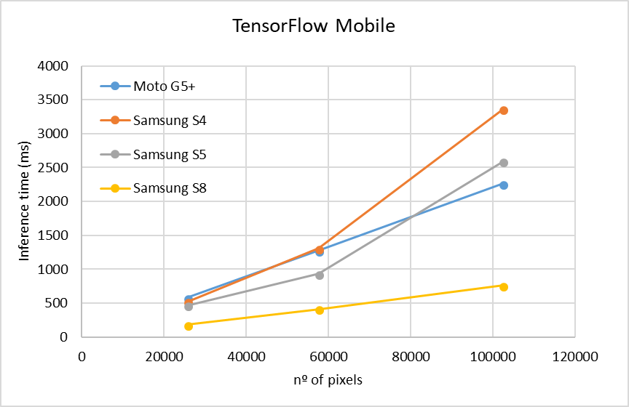
Comparison Across Devices

Slide 22

ConClusions
TF Lite still aprox 2x slower than TF Mobile for CNNs.
A more modern OS helps with big workloads.
Future Work:
NNAPI.
More devices
Compare with other frameworks (Theano, Torch, Infer.Net)

Slide 23


